Slide 1
Mini Project
32112 - Vishal Bhokre
32113 - Vedant Butala
32134 - Sumedh Kasat
Project Ideas Presentation

Slide 2
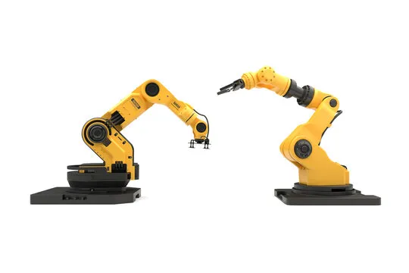
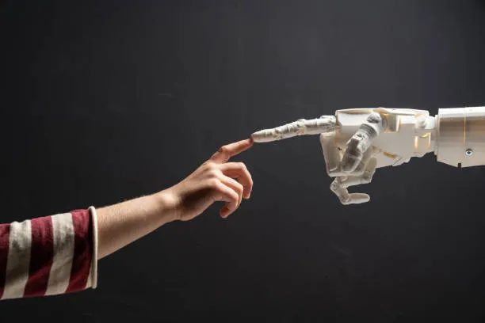
1] Mechanically Controlled Robotic Arm
A robotic arm is a programmable mechanical arm, typically with similar functions to a human arm. It's often used in industrial settings or for research purposes.

Slide 3
Types of robotic arms:
Serial: These arms have a series of links connected in a chain, like a human arm. They offer the most flexibility but can be complex to control.
Parallel: These arms have multiple limbs that move together, like a scissor lift. They are simpler to control but offer less flexibility.
Cartesian: These arms move in three linear axes (X, Y, and Z), like a gantry crane. They are good for tasks that require precise positioning.
Applications of robotic arms:
Manufacturing: Robotic arms are used in a variety of manufacturing tasks, such as welding, assembly, and painting.
Surgery: Robotic arms are used in minimally invasive surgery, where they can make small incisions and perform delicate procedures.
Exploration: Robotic arms are used in underwater and space exploration, where they can perform tasks that are too dangerous or difficult for humans.

Slide 4
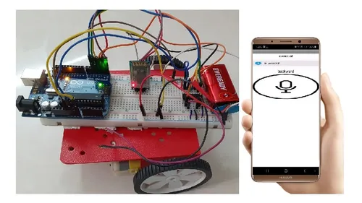
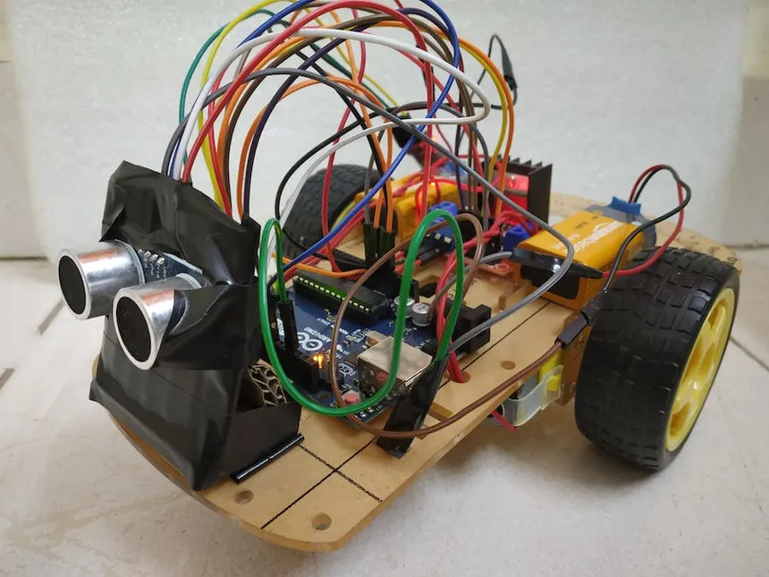
2] Voice Controlled Robotic Vehicle
A voice-controlled robotic vehicle (VCRV) is a type of mobile robot controlled by spoken commands instead of traditional methods like physical buttons or controllers.

Slide 5
How it works:
Speech recognition: The vehicle captures your voice commands using a microphone and a speech recognition system.
Command processing: The system interprets your commands and determines the desired action.
Navigation and control: The vehicle executes the command through motors, actuators, and other control systems.
Features and capabilities:
Basic movements: Forward, backward, turn left, turn right, stop.
Advanced functions: Speed control, obstacle avoidance, route planning, environmental sensing.
Applications: Research, exploration, delivery, hazardous environments, assisting persons with disabilities.
Benefits:
Hands-free control: More convenient and frees up hands for other tasks.
Safe operation: Avoids the need for physical interaction in dangerous environments.
Accessibility: Enables use by people with limited mobility or dexterity.

Slide 6
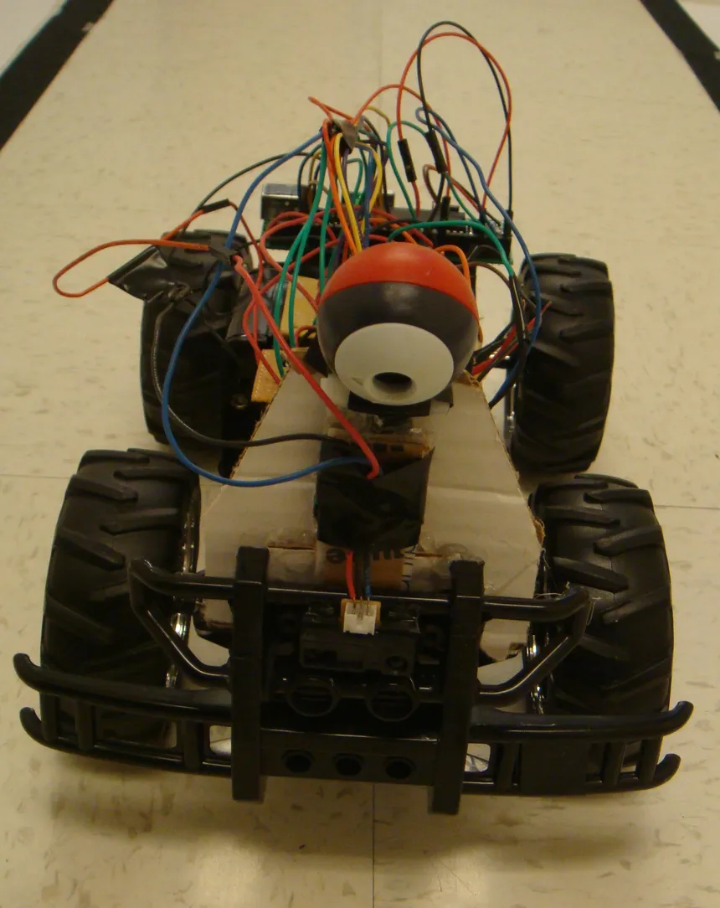
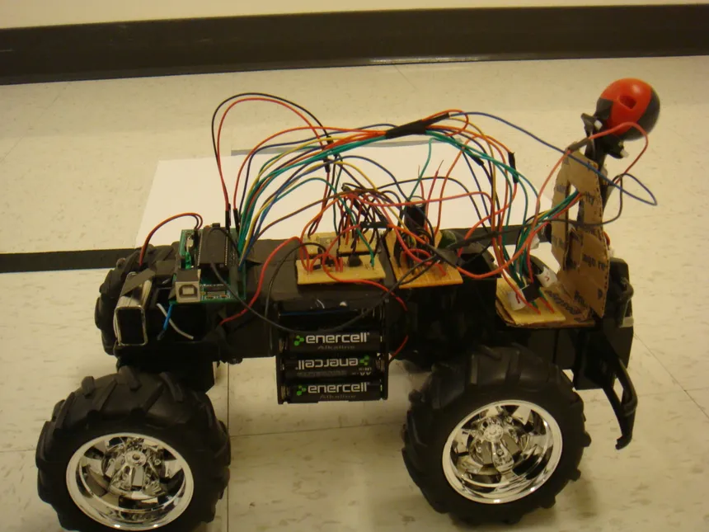
3] Cruise Controlled E-Vehicle
Cruise Controlled Electric Vehicles: Gliding into the Future
Cruise control on electric vehicles (EVs) takes the convenience and efficiency of this driver-assistance feature to a whole new level, enhancing your driving experience and potentially boosting your EV's range.

Slide 7
What is cruise control and how does it work in EVs?
Cruise control, in essence, is an autopilot for maintaining a constant speed. In EVs, it works by electronically controlling the electric motor based on inputs from various sensors like wheel speed, radar, and lidar. These sensors monitor the surrounding environment and vehicle performance, allowing the system to adjust power delivery and maintain your desired speed, even on slight inclines or declines.
Benefits of cruise control in EVs:
Increased Range: Maintaining a steady speed is key to maximizing EV range. Cruise control helps avoid unnecessary acceleration and deceleration, which can be energy-intensive for electric motors.
Reduced Driver Fatigue: Long highway drives become more relaxing with cruise control, as you don't have to constantly adjust your foot pressure on the accelerator pedal.
Improved Safety: By minimizing distractions and maintaining a consistent speed, cruise control can potentially contribute to safer driving on highways.

Slide 8


